Slide 1
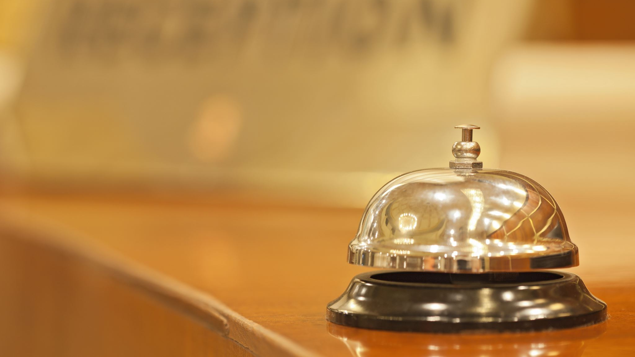
Hotel cancellations

Slide 2

problem

Slide 3
tackle the issue of hotel booking cancellations

Slide 4

WHY?

Slide 5
UNDERSTAND HOW A CANCELLATION CAN BE AVOIDED

Slide 6

How?

Slide 7
by building a model to predict whether a reservation will be canceled (1) or not (0)

Slide 8

SUPERVISED MODEL

Slide 9

DESCRIPTION OF THE DATASET

Slide 10
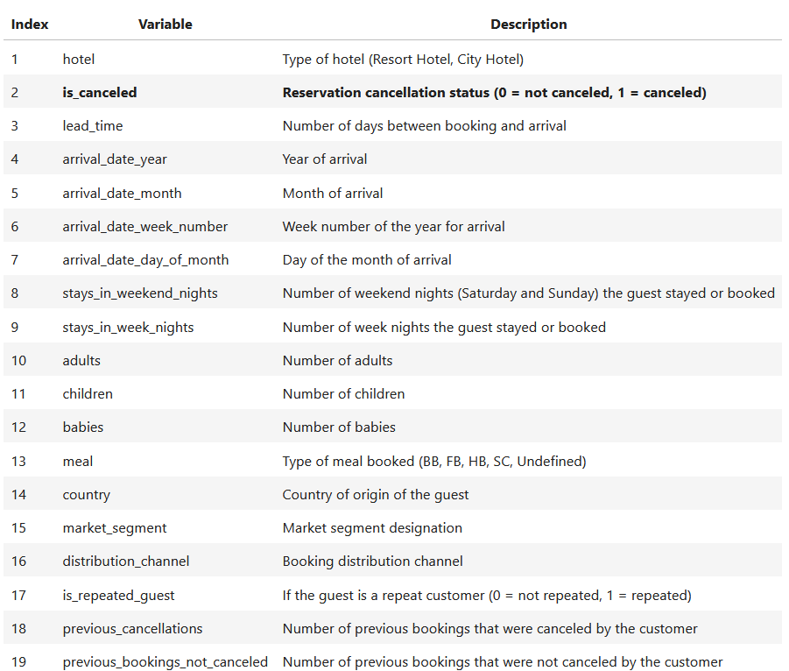
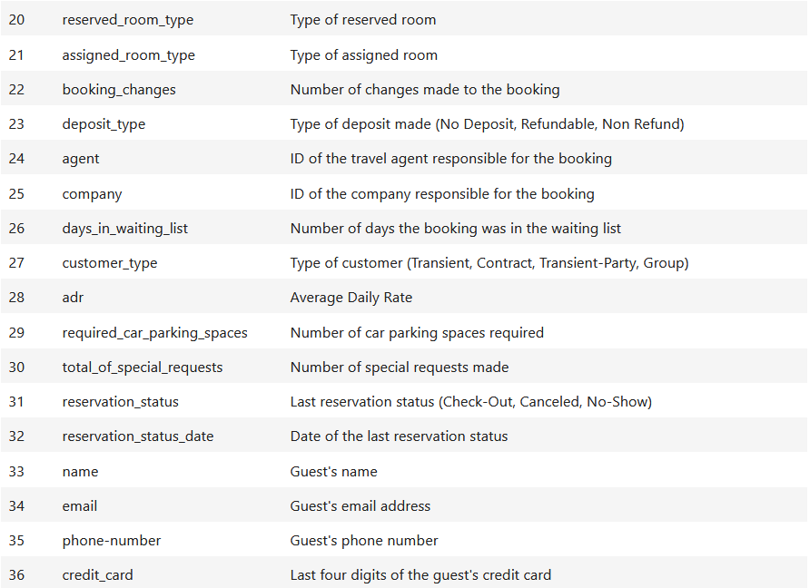

Slide 11

A total of 119,390 entries spread across: - 36 columns, of which - 16 are of type object, and - 20 are numerical of type int64/float64

Slide 12

Distribution of the target

Slide 13
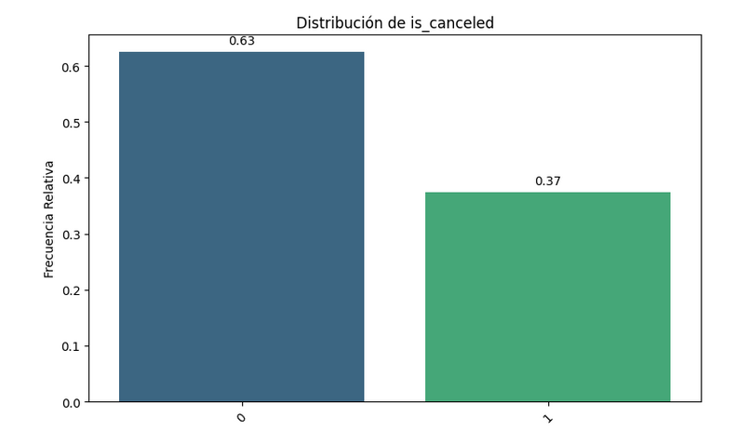

Slide 14

XGBOOST

Slide 15
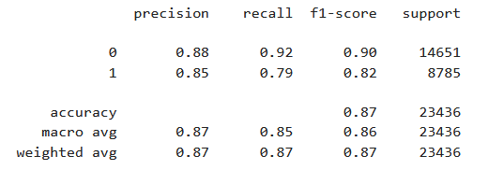
XGBOOST
Accuracy
2. Cancellation Prediction Precision
3. Cancellation Recall
4. F1-Score for Cancellations

Slide 16

How to Avoid cancellations?

Slide 17
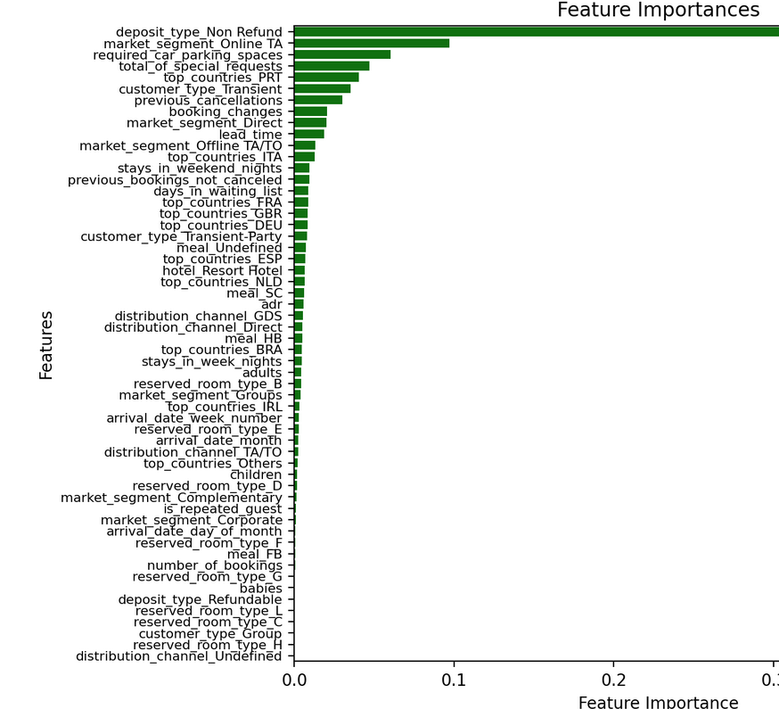
How to Avoid cancellations?

